Slide 1
Supecar company
Negotiations team

Slide 2
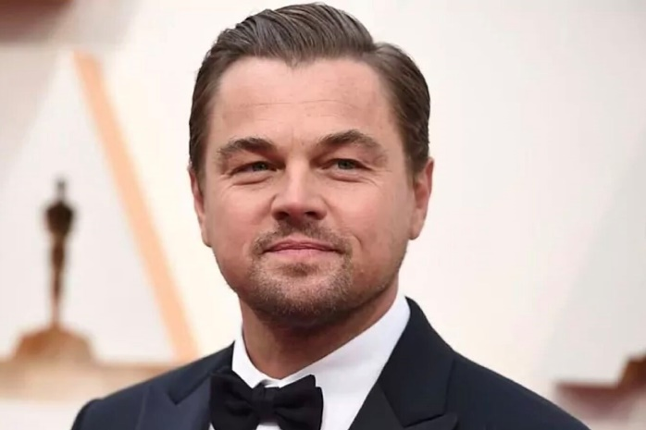
General director
Name: Leonardo DiCaprio
Age: 40
Education: MBA
Status: Not married
Hobby: Drive a car
Experience: 20 years
Characteristics:
Responsible
Selfish
Educated
Calm
Honest
Hard working

Slide 3
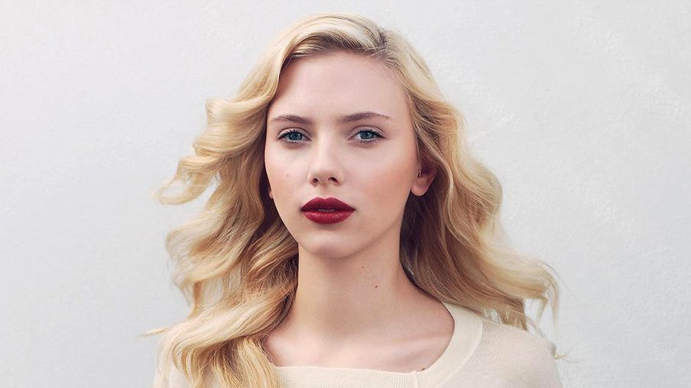
Financial director
Name: Scarlett Johansson
Age: 40
Education: Finance
Status: Married, 1 child
Hobby: Drink wine
Experience: 17
Characteristics:
Hard working
Love numbers
Doesn’t trust anyone
Objective
Realistic

Slide 4
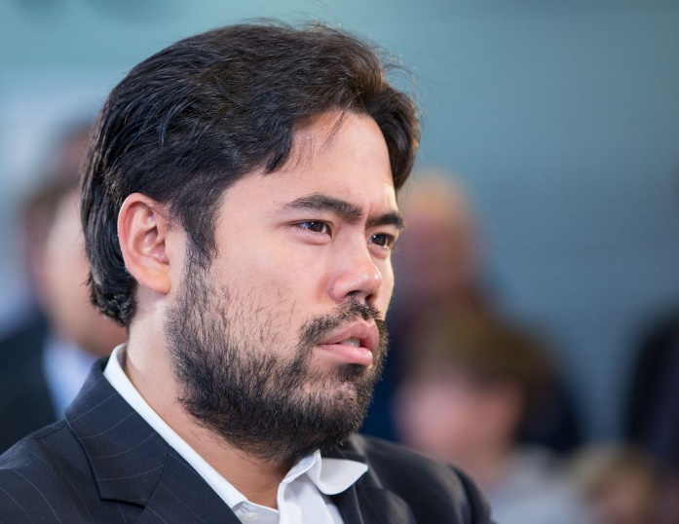
Engineer
Name: Hikaru Nakamura
Age: 40
Education: Car Engineering
Status: Not married
Hobby: Create 3d models
Experience: 30
Characteristics:
Responsible
Hard working
Love engineering
Active
Honest
Perfectionist
Understandable

Slide 5
Supermarketing company
Negotiations team

Slide 6
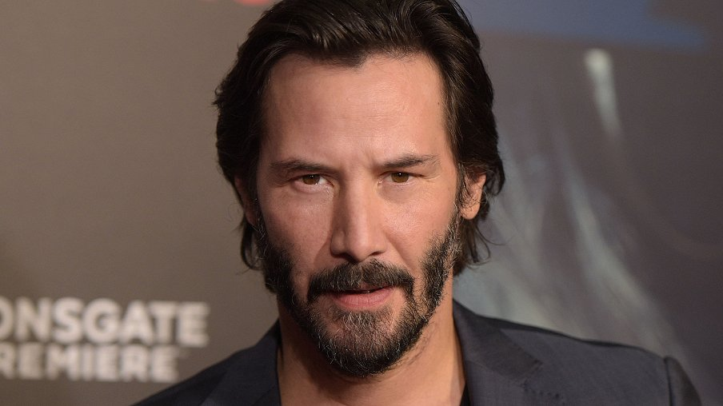
General director
Name: Keanu Reeves
Age: 70
Education: Marketing
Status: Married, 2 child
Hobby: Watch TV shows
Experience: 50
Characteristics:
Calm
Active
Hot-tempered
Looking for approach
Positive
Innovative
Goal oriented

Slide 7
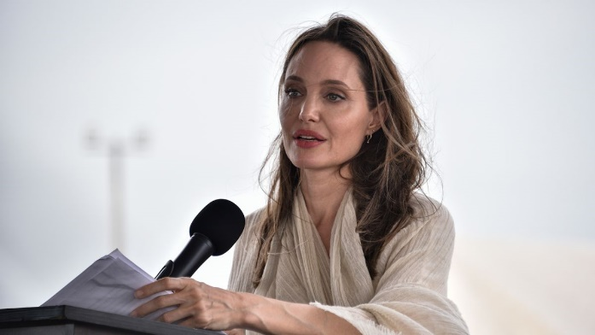
Financial director
Name: Angelina Jolie
Age: 35
Education: Account management
Status: Married, 1 child
Hobby: Law
Experience: 10
Characteristics:
Understandable
Calm
Goal oriented
Realistic
Love numbers
Perfectionist

Slide 8
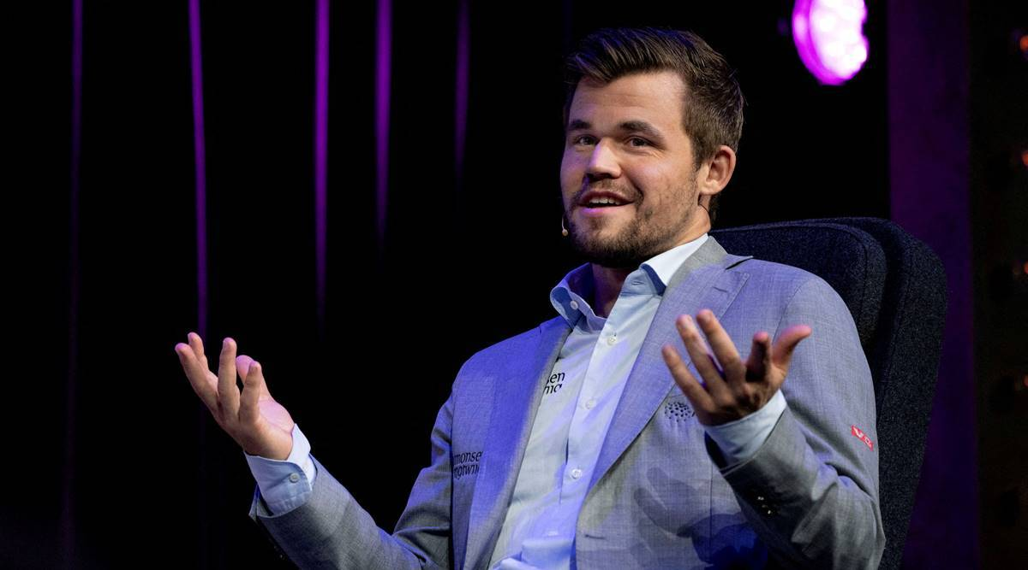
Ads creator
Name: Magnus Carlsen
Age: 25
Education: self-educated
Status: not married
Hobby: play video games
Experience: 5
Characteristics:
Not responsible
Not calm
Active
Hot-tempered
Flexible
Funny

